Slide 1
Brookfield Junior Programme
Whereto next ?

Slide 2
Agenda
TheCoaching Programme
Covid-19 Selected Guidelines
Update from Junior Committee

Slide 3
Philosophy
“To train intelligent, agile and ethical athletes for tennis and, to contribute to the opportunities for families, adults and children to enjoy tennis at all standards of play”

Slide 4
Values
What the Club believes in and how it behaves
Safe environment
Respectful
Loyal
Inclusive
Ambitious
Transparent
Courageous

Slide 5
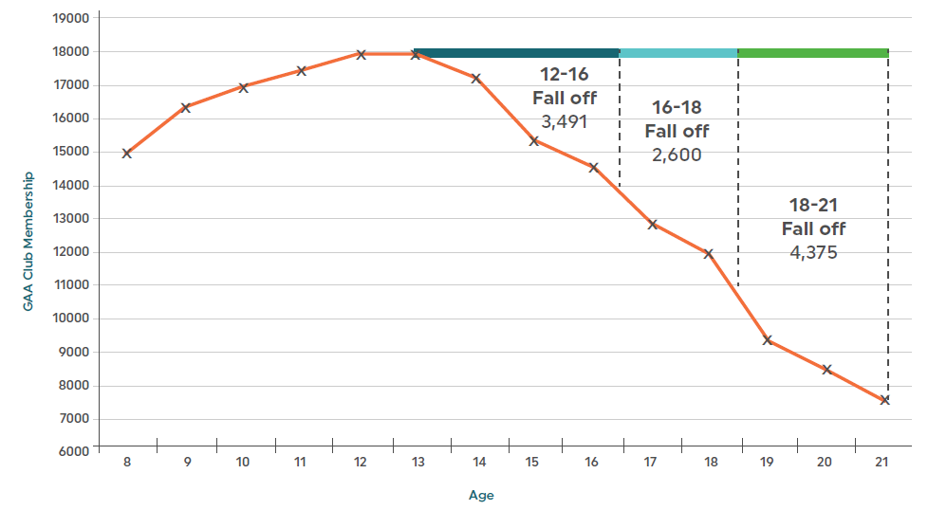
A frightening example
Lavallee, Sheridan et al., A social support intervention to reduce intention to drop-out from youth sport: the GAA super games centre. Psychosocial Intervention, 28(1), 11-17.
Notes:
Reference
Open letter in limerick leader - youngster that stopped playing
General sport dropout

Slide 6
Why do youngsters drop out of sport
Males
Females
Note: Figures are calculated using participants who reported dropping out of a previous sport only.
Hardie Murphy, M., Rowe, D.A., and Woods, C.B. (2016) Impact of physical activity domain on subsequent activity in youth: A 5-year longitudinal study. Journal of Sports Sciences.

Slide 7
Transitioning
Childhood
Early Adolescence
Late Adolescence
Up to ~11 years old
Multi-sport focused
Seasonal sports
Total organized hours ≤ age
Playful (20% “teaching”, 80% doing)
Mostly general training.
From ~16 years old
Option to invest in one primary sport
Mostly organized practice
Serious practice
Increasingly specialised training
~12-15 years
Complicated
Social
Physical
Emotional
Cognitive
Everything is always changing

Slide 8
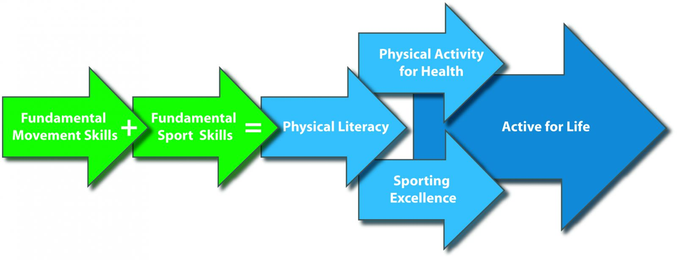
Physical Literacy

Slide 9
Physical Literacy & Multi-Skills Jigsaw
FUNdamentals of Movement (FoM)
Building blocks of safe and efficient movement. They include Balance, Coordination, Agility and Speed.
FUNdamental Movement Skills (FMS)
Combinations of the FoM which produce a specific movement pattern.
Sport Specific Technical & Tactical Skills (SSTTS)
These are specific techniques and tactics that are needed for a specific sport.
FUNdamental Game Skills (FGS)
Generic skills involved in solving the recurrent tactical challenges that are shared between most games.

Slide 10
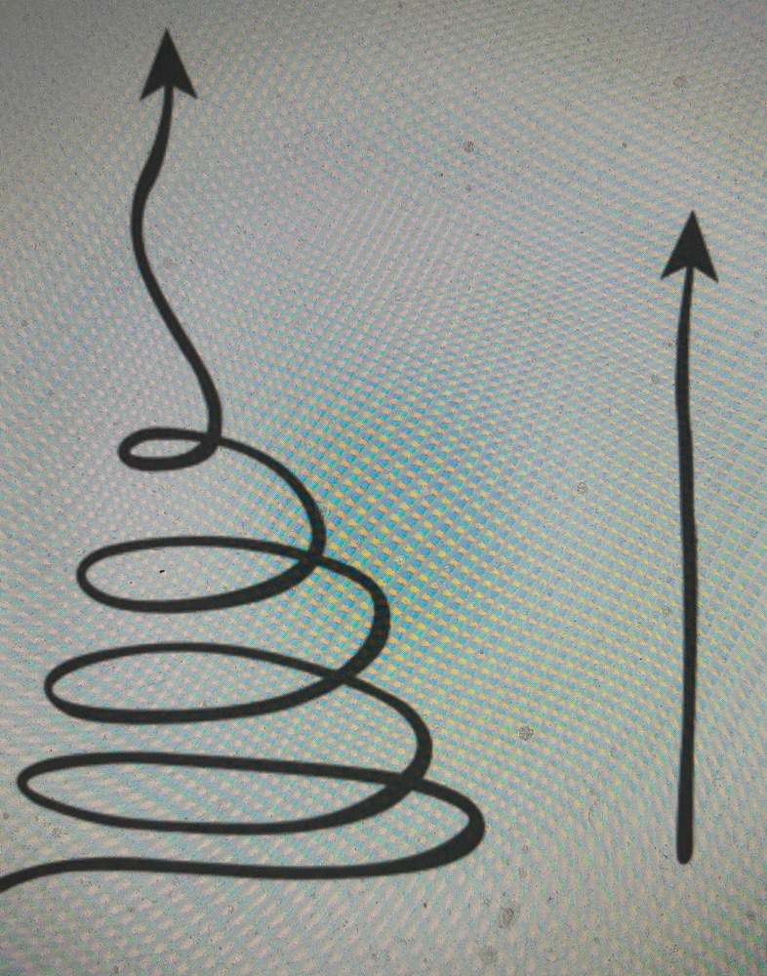
All round Development

Slide 11
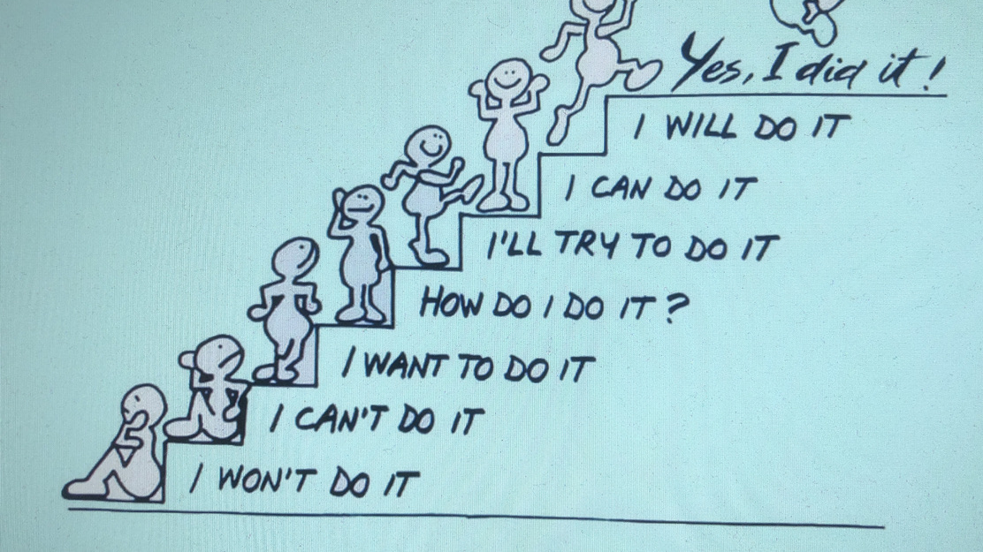
Questions ?

Slide 12
Players should travel to the club alone, or only with a member of the same household. There should be no carpooling between households.
Players should arrive at the court entrance no more than 5 minutes prior to the reserved playing time. It is important that players maintain social distancing and wait in a pre- designated waiting area that allows for social distancing
Players should always observe social distancing and resist the temptation to mingle
Players should sanitise their hands using dispensers provided at the entrance to the club and courts
Players should head straight to their designated court unless required to check-in
Players should ensure that they utilise toilet facilities in their own home prior to arriving at the club.
Players should remain apart from other players when taking a break.
A maximum of 4 junior players (u18 yrs) can operate on the court at any one time while remaining in their own sections of the court with up to 2 other players rotating in and out as required.
All activities are subject to strict social distancing and those players not on court must always maintain a clear 2m distance from others.

